Slide 1
HTTP2 to HTTP3 Packet structure and content difference
Tal Malka & Yan Chich
HTTP/3 Attacks B.Sc. Final Project

Slide 2
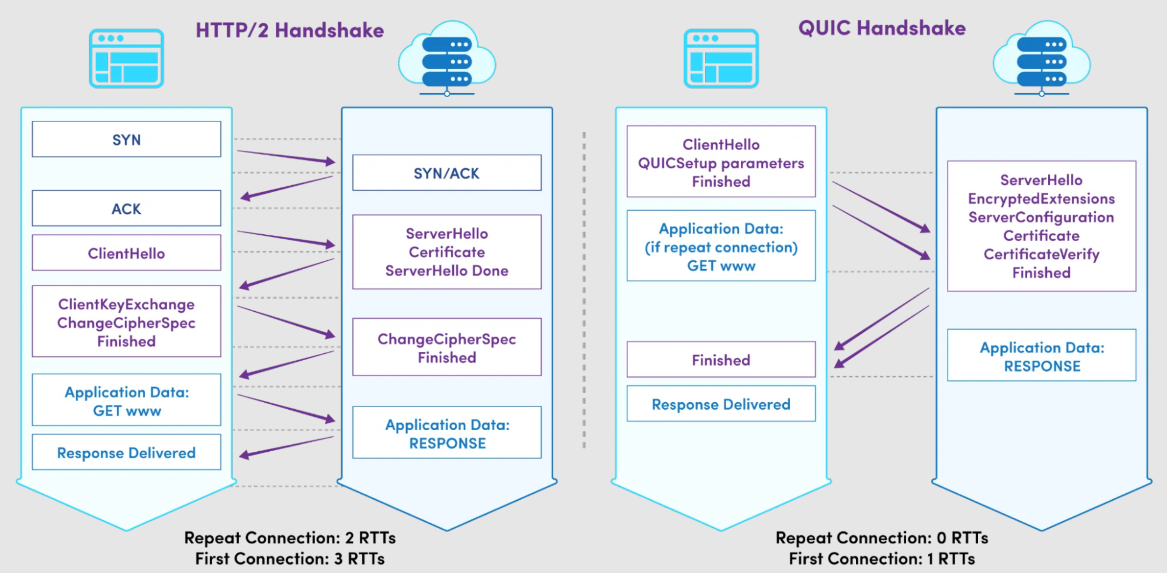

Slide 3

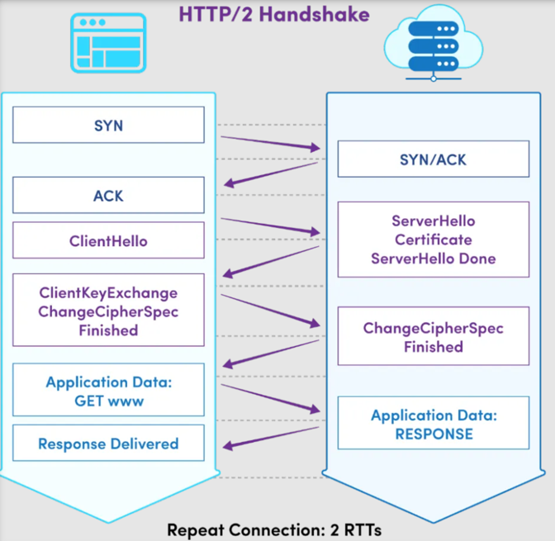
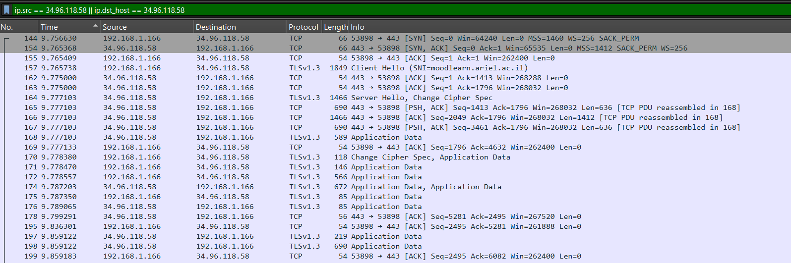







Slide 4
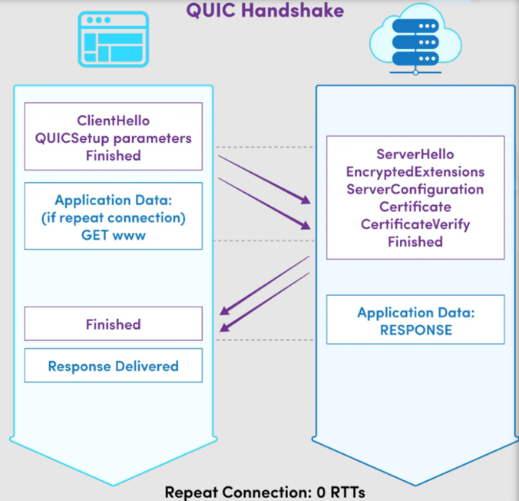
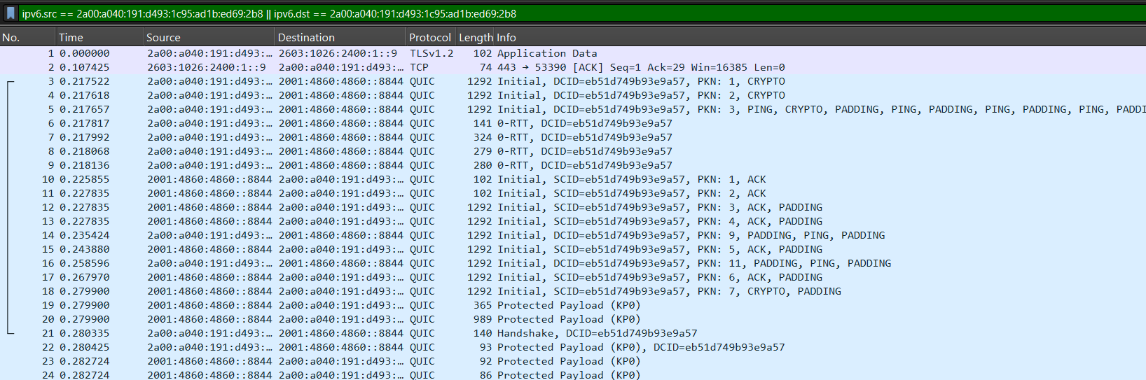




Slide 5
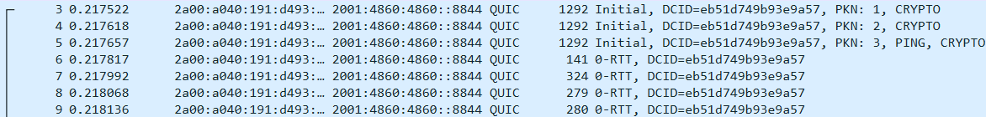
Further analysis QUIC Handshake - Client
Packet 3
Type: Initial
Direction: Client → Server
Details: Contains the Destination Connection ID (DCID) eb51d749b93e9a57 and Packet Number (PKN) 1.
Purpose: Starts the QUIC handshake by sending the first cryptographic data (CRYPTO frame) as part of the TLS handshake.
Packet 4
Type: Initial
Direction: Client → Server
Details: Contains the DCID eb51d749b93e9a57 and PKN 2.
Purpose: Continues the QUIC handshake with additional cryptographic data (CRYPTO frame) to progress the TLS handshake.
Packet 5
Type: Initial
Direction: Client → Server
Details: Contains the DCID eb51d749b93e9a57 and PKN 3.
Purpose: Combines multiple QUIC frames, including PING (used to keep the connection alive), CRYPTO (for handshake data), and PADDING (to ensure packet size for Initial packets).
Packet 6
Type: 0-RTT (Zero Round Trip Time)
Direction: Client → Server
Details: Contains the DCID eb51d749b93e9a57.
Purpose: Sends early application data using 0-RTT encryption, which can
speed up repeated connections by allowing data transmission without waiting
for the handshake to complete.
Packet 7
Type: 0-RTT
Direction: Client → Server
Details: Contains the DCID eb51d749b93e9a57.
Purpose: Additional early application data transmission.
Packet 8
Type: 0-RTT
Direction: Client → Server
Details: Contains the DCID eb51d749b93e9a57.
Purpose: Another packet carrying early application data encryption.
Packet 9
Type: 0-RTT
Direction: Client → Server
Details: Contains the DCID eb51d749b93e9a57.
Purpose: Further transmits early application data.

Slide 6
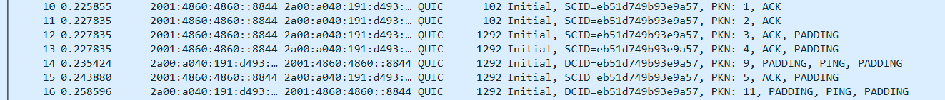
Further analysis QUIC handshake - Server
Packet 10
Type: Initial
Direction: Server → Client
Details: Contains the Source Connection ID (SCID) eb51d749b93e9a57 and PKN 1.
Purpose: Acknowledges the client’s Initial packets using an ACK frame.
Packet 11
Type: Initial
Direction: Server → Client
Details: Contains the SCID eb51d749b93e9a57 and PKN 2.
Purpose: Additional acknowledgment of Initial packets from the client.
Packet 12
Type: Initial
Direction: Server → Client
Details: Contains the SCID eb51d749b93e9a57 and PKN 3. Includes ACK and PADDING frames.
Purpose: Finalizes acknowledgment of Initial packets and ensures the packet size requirements for Initial packets are met.

Slide 7
Content change HTTP/2 to HTTP/3
Frame 1: TCP [SYN]
--------------------------------
Source Address: 192.168.1.2
Destination Address: 172.217.14.206
Source Port: 54721
Destination Port: 443
Flags: SYN
Sequence Number: 0
Acknowledgment Number: 0
Frame 2: TLS [ClientHello]
--------------------------------
Source Address: 192.168.1.2
Destination Address: 172.217.14.206
TLS Record Type: Handshake
Handshake Type: ClientHello
Version: TLS 1.3
Session ID: 0x8a3b...
Frame 3: HTTP/2 [HEADERS]
--------------------------------
Source Address: 192.168.1.2
Destination Address: 172.217.14.206
Stream ID: 1
Type: HEADERS
Header Block:
:method: GET
:path: /index.html
:scheme: https
:authority: www.example.com
Frame 1: QUIC [Initial]
--------------------------------
Source Address: 192.168.1.2
Destination Address: 172.217.14.206
Source Port: 54721
Destination Port: 443
QUIC Header:
DCID: fbdc2a1b9b43...
SCID: a3fb9c4e2d85...
Packet Number: 1
QUIC Frame:
Type: CRYPTO
Content: ClientHello
Frame 2: QUIC [Handshake]
--------------------------------
Source Address: 192.168.1.2
Destination Address: 172.217.14.206
QUIC Header:
DCID: fbdc2a1b9b43...
SCID: a3fb9c4e2d85...
Packet Number: 2
QUIC Frame:
Type: CRYPTO
Content: ServerHello
Frame 3: HTTP/3 [HEADERS]
--------------------------------
Source Address: 192.168.1.2
Destination Address: 172.217.14.206
QUIC Header:
DCID: fbdc2a1b9b43...
Stream ID: 1
HTTP/3 Frame:
Type: HEADERS
Header Block:
:method: GET
:path: /index.html
:scheme: https
:authority: www.example.com

Slide 8
Side-by-side Comparison HTTP/2 to HTTP/3
Feature | HTTP/2 (TCP + TLS) | HTTP/3 (UDP + QUIC)
Packet 1 | TCP SYN: Establishing connection | QUIC Initial: ClientHello in CRYPTO frame
Packet 2 | TLS ClientHello: Starting encryption | QUIC Handshake: ServerHello in CRYPTO frame
Packet 3 | HTTP/2 HEADERS: Request data sent over secure connection | HTTP/3 HEADERS: Request data in a QUIC stream
Header Compression | HPACK (used in HTTP/2) | QPACK (used in HTTP/3)
Retransmissions | TCP-based (affects all streams) | QUIC-based (stream-specific retransmissions)

